Slide 1

SLB HACKTHON
HSE LANGUAGE TRANSLATION

Slide 2




WHAT WE HAVE MADE
LANGUAGE TRANSLATION APP
This document outlines the workflow for translating text from a given language to another specified language in several steps. The process involves creating a dictionary of possible headings, filtering these headings, extracting sub-headings, and finally translating the text. The goal is to enhance translation quality and readability by organizing the text into meaningful sections.
SLB HACKTHON

Slide 3

ABOUT MODEL
1. Creating Dictionary of Possible Headings:
- Generate possible headings based on the following criteria:
- If the word count in a line is less than or equal to 3.
- If a colon is present in the line, take the slice to the left of the colon as a possible heading if the word count is less than or equal to 3.
- Store these possible headings in a dictionary where keys represent the possible heading, and the values are tuples of start and end indices of the possible heading in the whole text.
2. Filtering Headings:
- Use a Language Model (LLM) to determine the closeness of each possible heading to certain English words such as 'Warning Statement', 'Overview', 'Emergency Contact Numbers', 'Assistance', and 'Advice'.
- Approve headings that are close to any of the above words based on the LLM's decision.
3. Chunking Text:
- Create chunks of text based on the approved headings.
- All the text between one approved heading and the next approved heading is taken as the body of the corresponding heading.
4. Extracting Sub-headings:
- Further enhance translation quality and readability by extracting sub-headings from the body chunks.
- Define rules to identify meaningful sub-headings within the body text.
5. Translation:
- Translate the text to the final language using the generated dictionary of headings as keys and body text as values.
- For headings like 'Overview', store a dictionary of sub-headings and text as the value.

Slide 4
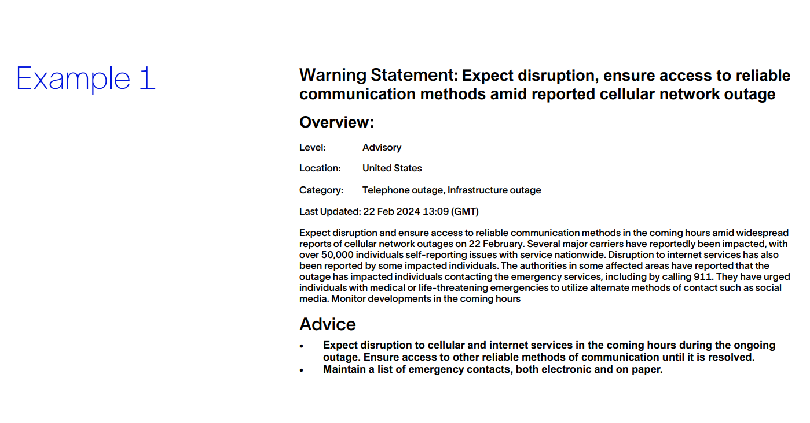
EXAMPLE

Slide 5
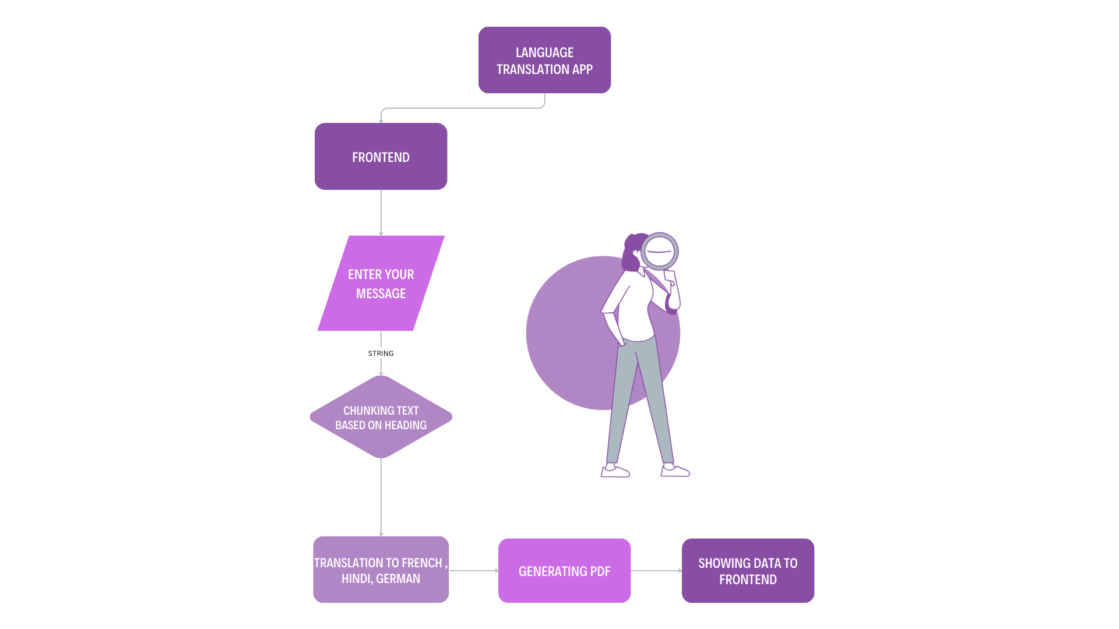
USER FLOW AND DEMO

Slide 6



THANK YOU
Team
Sarvagya porwal
Shivam kumar
Puspendra mahariya

